Slide 1
INF1002 Programming Fundamentals (AY2025-T1)
C – Lab3
7-Nov-2025 (Week 10)

Slide 2
INF1002 – Programming Fundamentals
Warmup Lab3:
EXE_1: POINTER SYNTAX
EXE_2: POINTER BASICS
Not required to submit.
Practice for quiz.
Gradescope Lab3 Task:
GUESS WORD
Gradescope Submission due
Thursday, 13-Nov-2025 23:59:00

Slide 3
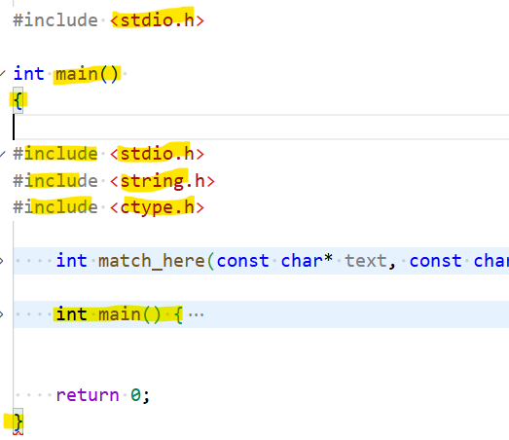
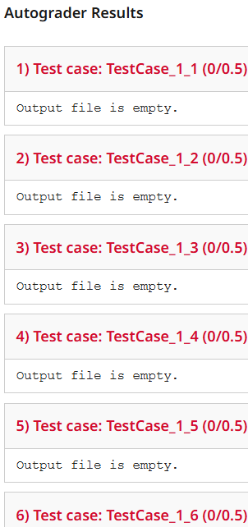
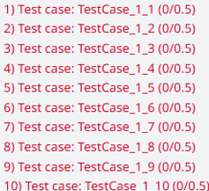
INF1002 – Programming Fundamentals
C Lab2 - Feedback
Compiled and created “exe“
But “exe” is not executable!
main() in main()?

Slide 4
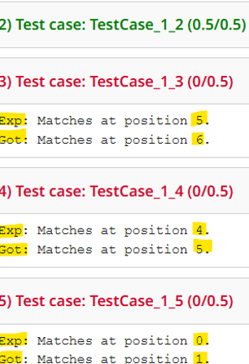
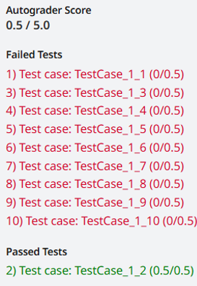
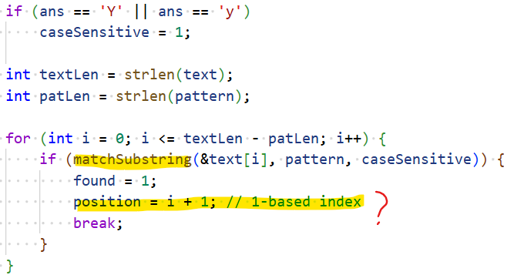
INF1002 – Programming Fundamentals
C Lab2 - Feedback
1-based index?

Slide 5
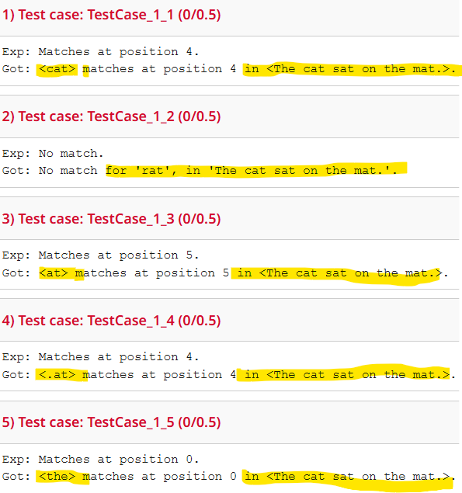
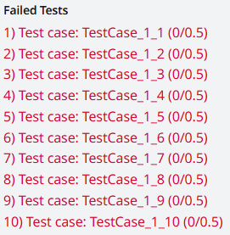
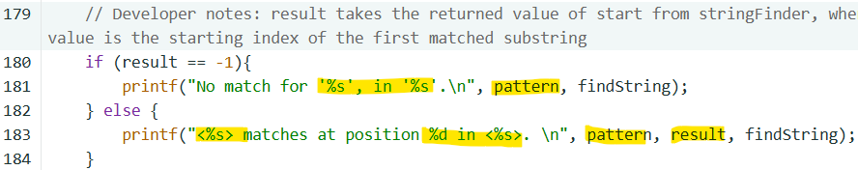
INF1002 – Programming Fundamentals
C Lab2 - Feedback
print requirements?

Slide 6
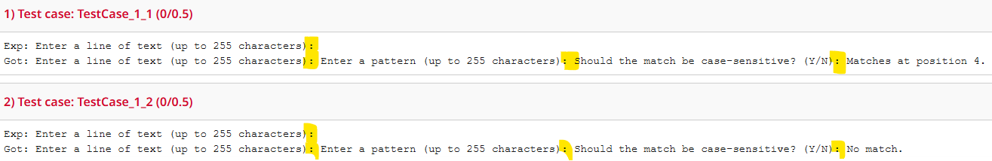
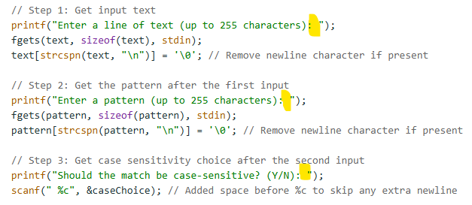
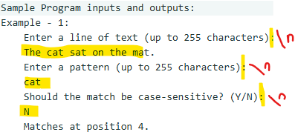
INF1002 – Programming Fundamentals
C Lab2 - Feedback
Not reading the program requirements!
Not following the examples!

Slide 7
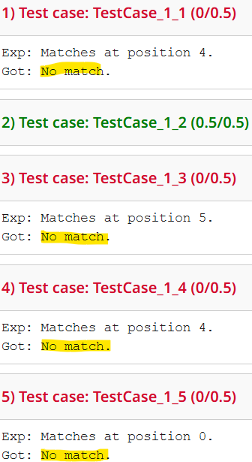
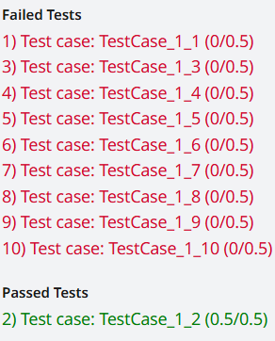
INF1002 – Programming Fundamentals
C Lab2 - Feedback
All 10 Test cases: “No match”!

Slide 8
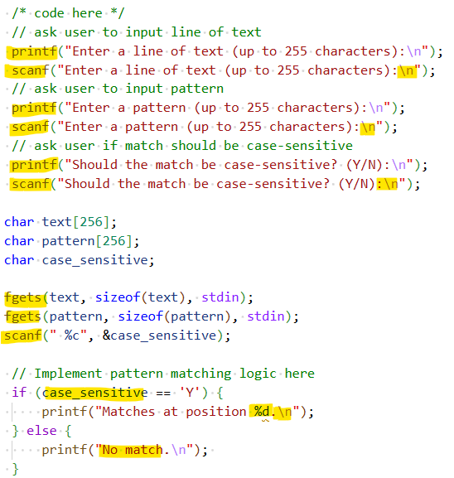


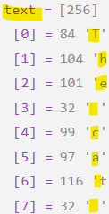
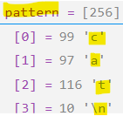
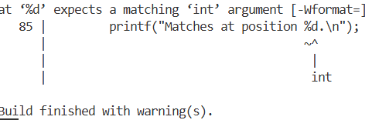
INF1002 – Programming Fundamentals
Syntax for scanf()?
‘grep’ code?

Slide 9
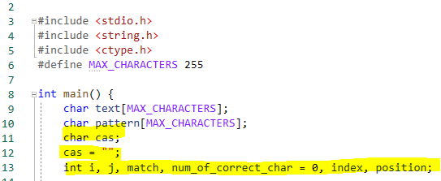
INF1002 – Programming Fundamentals
Variable declaration and initialization
 | Python | C
Variable Declaration (aka introduction) | Has no command for declaring a variable. A variable is created the moment a value is assigned to it. Ex: age = 20 | Declared by a data type and a name Ex: int age; (variable age holds random value)
Variable Initialization (aka definition) |  | Ex: age = 20;
Variable Declaration and initialization at the same time |  | Ex: int age = 20;
In C and C++:
Local variables aren't initialized by default. Uninitialized variables can contain any value, and their use leads to undefined behavior
Global and static variables are initialized to their default values

Slide 10
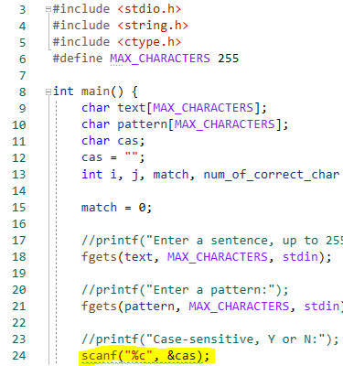
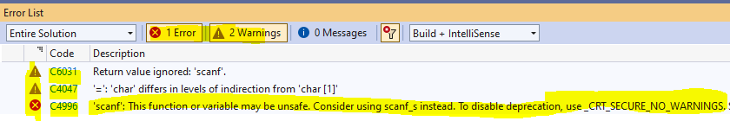


INF1002 – Programming Fundamentals
Warnings and Errors
Compiler warnings
Indicate code that is syntactically correct but is likely to lead to run time errors
Avoid system specific features
Code that works on many systems without modification is called portable
OR
CRT means C Run Time

Slide 11
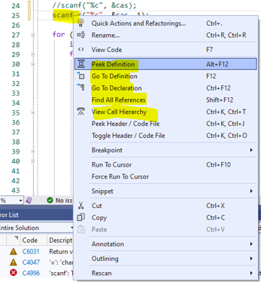
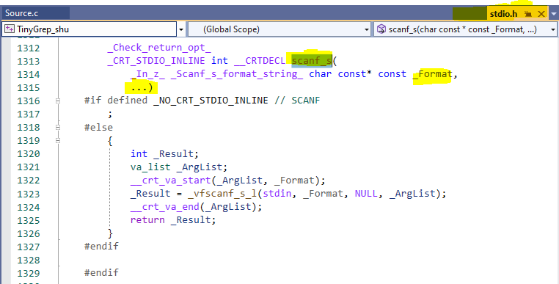
INF1002 – Programming Fundamentals
Check Function prototypes and header files
How: Click the function name to get a context menu
Note: There dots allow zero to multiple arguments to be passed when the function is called
https://learn.microsoft.com/en-us/cpp/c-runtime-library/reference/scanf-s-scanf-s-l-wscanf-s-wscanf-s-l?view=msvc-170
https://en.cppreference.com/w/

Slide 12
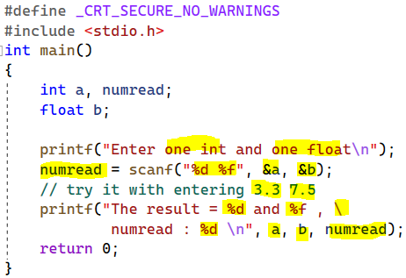
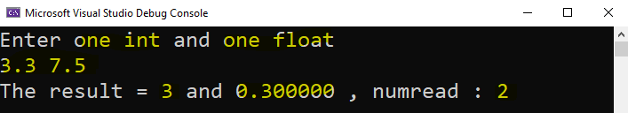
INF1002 – Programming Fundamentals
scanf()
Reads from the standard input (stdin), which is usually the keyboard
Keeps in stdin what it has not consumed
Can have side effects when reading more than one variable due to "leftovers" in stdin
Has no range checking for arrays, can lead to buffer overflows
Returns the number of fields that were successfully converted and assigned
Credited to:
Prof. Alexander Binder

Slide 13
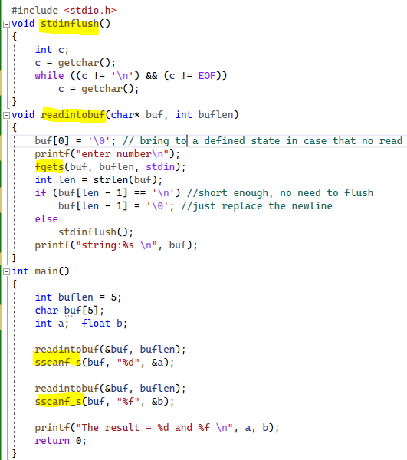
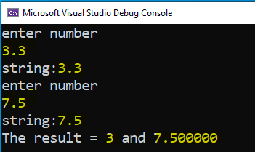
INF1002 – Programming Fundamentals
scanf()
DO NOT USE SCANF!!!
Safer (needs to use arrays):
Read each input value separately using fgets() and flushing
fgets() to obtain a string of fixed maximal length, then flush the stdin stream
Then use sscanf() to get formatted data from the string preferably for one variable every time
Credited to:
Prof. Alexander Binder

Slide 14
INF1002 – Programming Fundamentals
Instructions to submit and auto grade your code to Gradescope:
Download the skeleton code file “guessWord.c” from the “C\Lab Assignments\Lab3” xSiTe folder.
Do not change file name or function names.
Add your code to the function “main()” and other required functions.
Don’t use sys.argv[] for user inputs. Use other functions such as scanf(), fgets(), fgetc(), etc.,
Drag and drop your locally tested code (guessWord.c) to Gradescope. You can submit and auto graded any number of times. Last submission counts.
There are 5 test cases and maximum score for this task is 5.
Autograder will be timed out after 10 minutes.

Slide 15
INF1002 – Programming Fundamentals
Control measures in Gradescope:
Autograder time out: Execute each test case for 30 seconds maximum and limit output to 50 lines
Missing new lines (“\n”) in printf(): Normalized actual and expected outputs.
Extra white spaces: Normalized actual and expected outputs.
Case sensitiveness: Not normalized.
Show first mismatch, or all expected (Exp) and actual (Got) outputs: depending on tasks
Environment:
OS: Ubuntu 22.04, Compiler: gcc (GNU C Compiler), CPU:1, RAM: 1.5 GB
scanf() / scanf_s():
scanf_s is a secure version of scanf available in the Microsoft C Runtime Library, which includes additional parameters for buffer sizes to prevent buffer overflows.
scanf is the standard input function available in the C standard library, which works on all platforms, including Linux.
If need to ensure input safety, add additional checks in the code to validate the input size and format

Slide 16
INF1002 – Programming Fundamentals
For Gradescope issues, Screen shot Gradescope result page and email to:
jacob.abraham@singaporetech.edu.sg

Slide 17
INF1002 – Programming Fundamentals
C Lab Assignments
Week # | C Lab # | Lab Date | Gradescope Release | Gradescope Due
8 | 1 | Friday, October 24, 2025 | Friday, October 24, 2025 08:00 | Thursday, October 30, 2025 23:59
9 | 2 | Friday, October 31, 2025 | Friday, October 31, 2025 08:00 | Thursday, November 6, 2025 23:59
10 | 3 | Friday, November 7, 2025 | Friday, November 7, 2025 08:00 | Thursday, November 13, 2025 23:59
11 | 4 | Friday, November 14, 2025 | Friday, November 14, 2025 08:00 | Thursday, November 20, 2025 23:59
12 | 5 | Friday, November 21, 2025 | Friday, November 21, 2025 08:00 | Thursday, November 27, 2025 23:59

